Slide 1
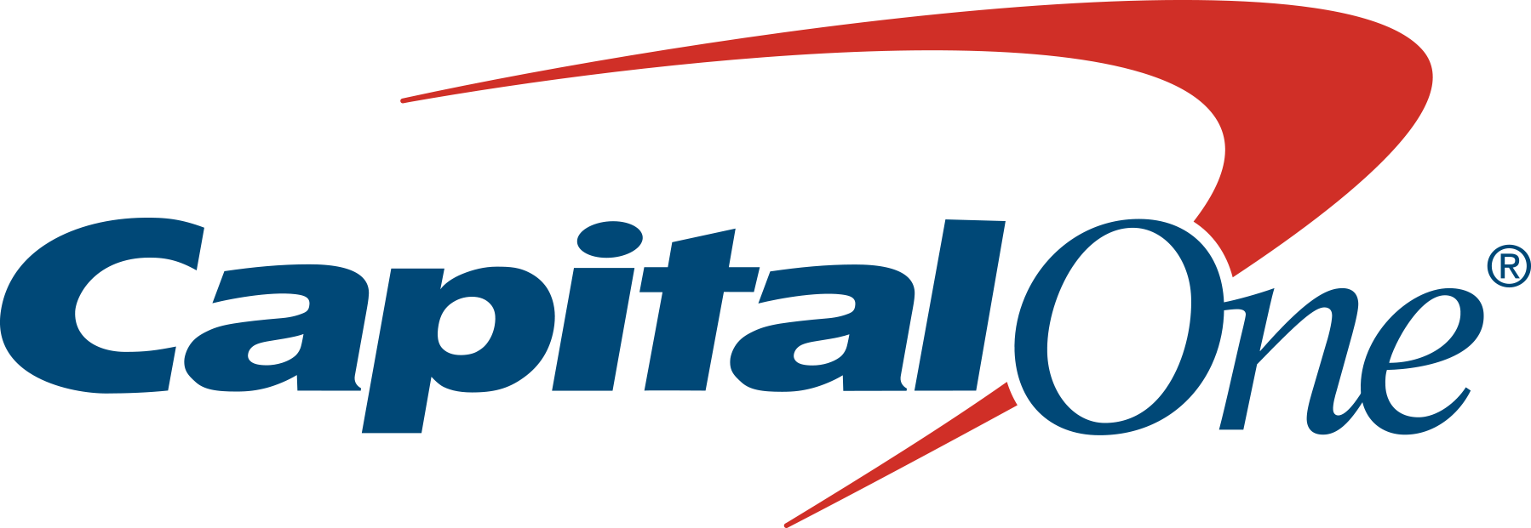
Airbnb Data Challenge
November 16, 2018
Author:
Amod Karambelkar
The University of Texas at Dallas

Slide 2
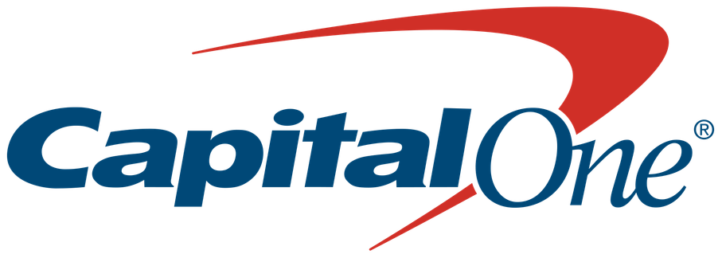
About Airbnb Dataset
Data has been acquired from listings.csv file & Zip_Zhvi_2bedroom.csv files
The listings dataset has 40754 rows & 95 columns
The Zillow dataset has 8947 rows & 262 columns
Common Data between two datasets based on Date, Zip code, State & City is taken to make a meaningful decision
Some of the key attributes of this dataset include:
Cost data to determine the average property price for 2 bedrooms
Information on the listing including location, number of bedrooms, room types (entire home/private home/shared home)

Slide 3
Problem Statement
To understand which zip codes would generate the most profit on short term rentals within New York City
To automate the code & make it scalable so that there is an option to expand to other Markets

Slide 4
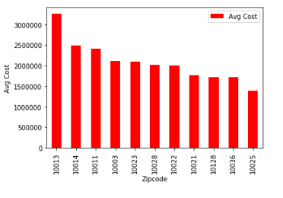
Average Cost vs Zip code
Average Cost help us understand which zip codes would have highest or lowest median purchase value
Average Cost of House is highest in Zip code 10013 & lowest in 10025

Slide 5
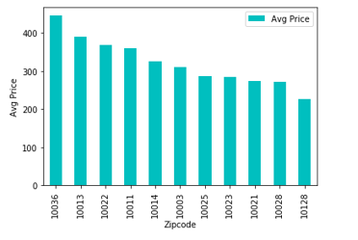
Average Price vs Zip code
Average Price help us understand what hosts are charging to stay per night
Average Price of house is highest in Zip code 10036 & lowest in 10128

Slide 6
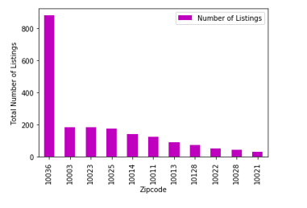
Total Number of Listings vs Zip code
Total Number of Listings help us understand how many properties host has ever listed on Airbnb
Total Number of listings are highest in Zip code 10036 & lowest in 10021

Slide 7
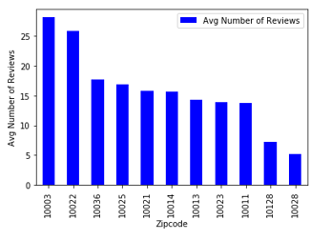
Average Number of Reviews vs Zip code
Average number of reviews are received for the property for its entire existence within Airbnb by Zip code
Average Number of Reviews are highest in Zip code 10003 & lowest in 10028

Slide 8
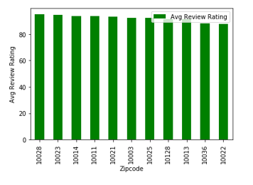
Average Review Rating vs Zip code
Average Review Rating is an average of overall score given based on accuracy, cleanliness, check-in, communication, location, and value
Average Review Rating are highest in Zip code 10028 & lowest in 10022

Slide 9
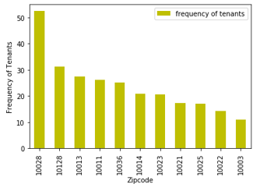
Frequency of Tenants vs Zip code
Frequency of Tenants is the ratio of Avg Price by Avg Number of Reviews & denotes the total number of people visiting the property & writing reviews after their stay
Frequency of Tenants are highest in Zip code 10028 & lowest in 10003

Slide 10
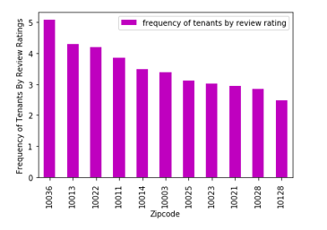
Frequency of Tenants (Rating) vs Zip code
Frequency of Tenants (Rating) is the ratio of Avg Price by Avg Review Rating & denotes the total number of people visiting the property & giving ratings after their stay
Frequency of Tenants (Rating) are highest in Zip code 10036 & lowest in 10028

Slide 11
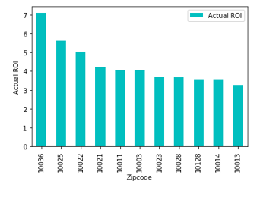
Return on Investment by Zip code
Return on Investment is the ratio of Sum of Price (Calculated Yearly i.e. multiply by 365 days) to the Sum of Cost assuming 75% occupancy rate
ROI is highest in Zip code 10036 & lowest in 10013

Slide 12
Conclusion
The Goal was to identify zip codes which would generate most profit in New York City.
The definition of profit was not given & hence zip codes to can vary to the criteria of:
Return On Investment (ROI): The top 3 zip codes to invest are 10036, 10025, 10022
Frequency of Tenants based on Ratings score (Brand Awareness): The top 3 zip codes to invest are 10036, 10013, 10022
Frequency of Tenants (Popularity): The top 3 zip codes to invest are 10028, 10128, 10013
Total Listings (Market Analysis): The top 3 zip codes to invest may depend on if we want to target market with less host listings or more

